Slide 1
Abu Dhabi University Library www.adu.ac.ae/library ADULibrary@adu.ac.ae
Library Orientation

Slide 2
Ways to Access the Library Website
Library website: http://www.adu.ac.ae/library
University’s website: http://www.adu.ac.ae
Student Online Account: http://my.adu.ac.ae

Slide 3
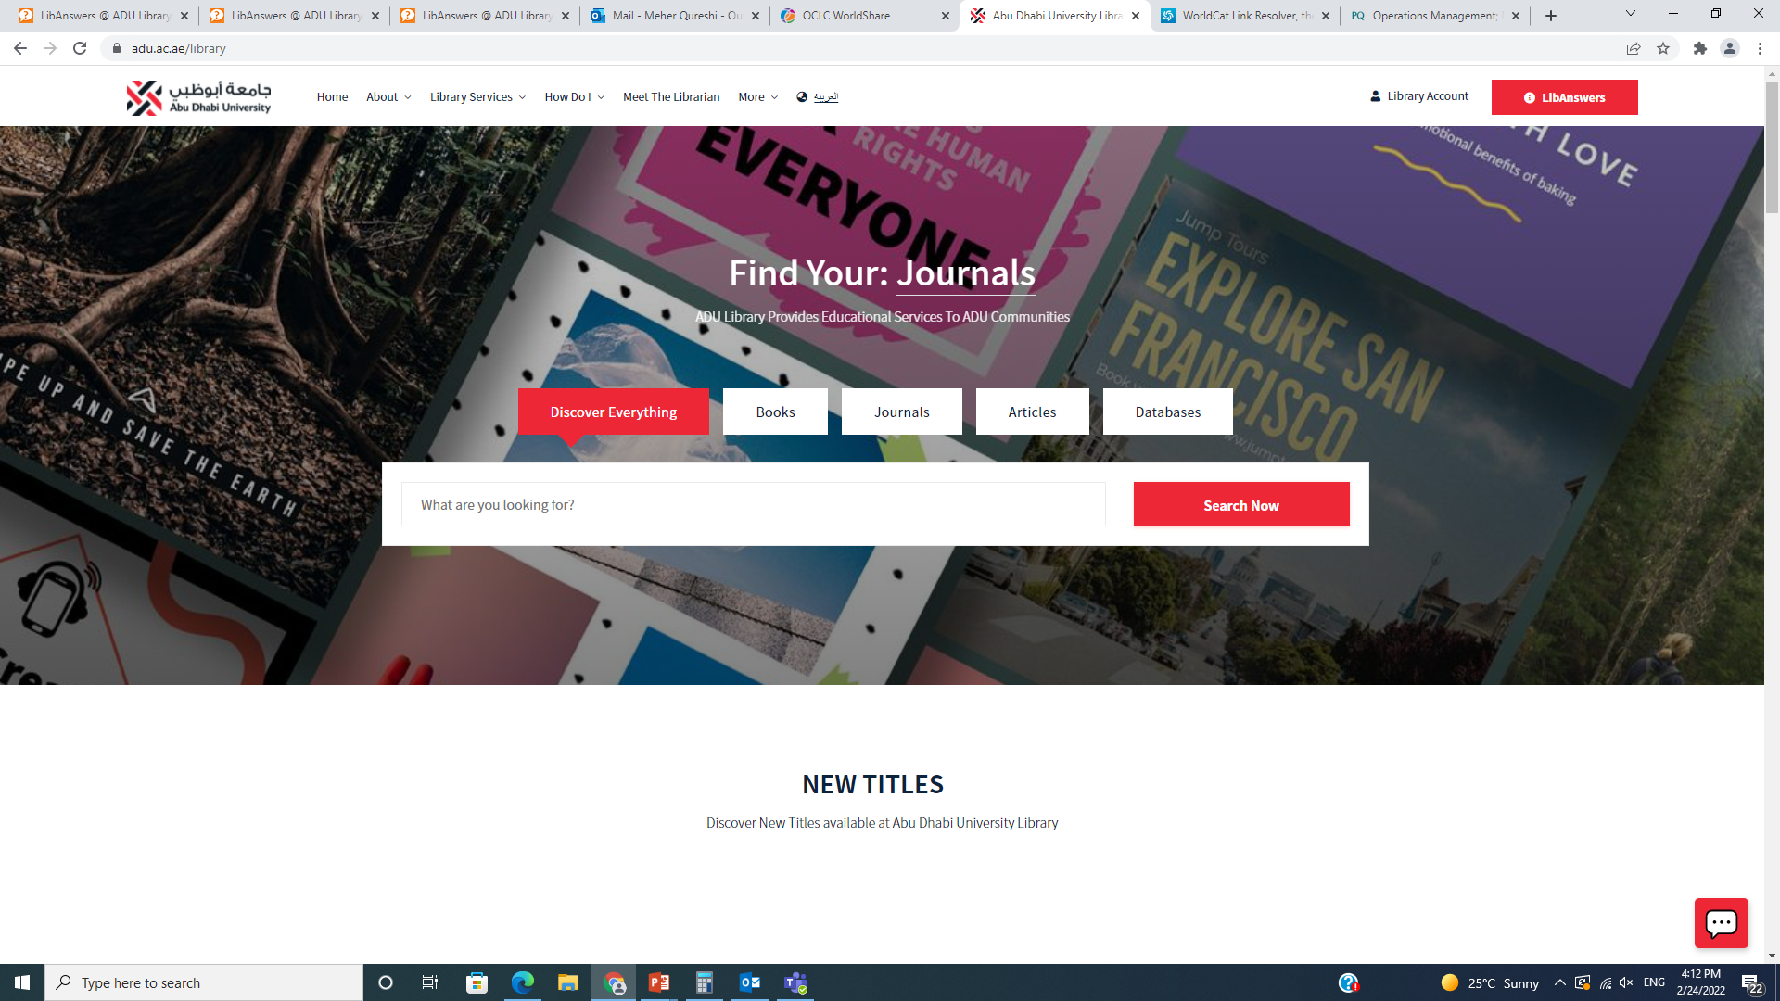
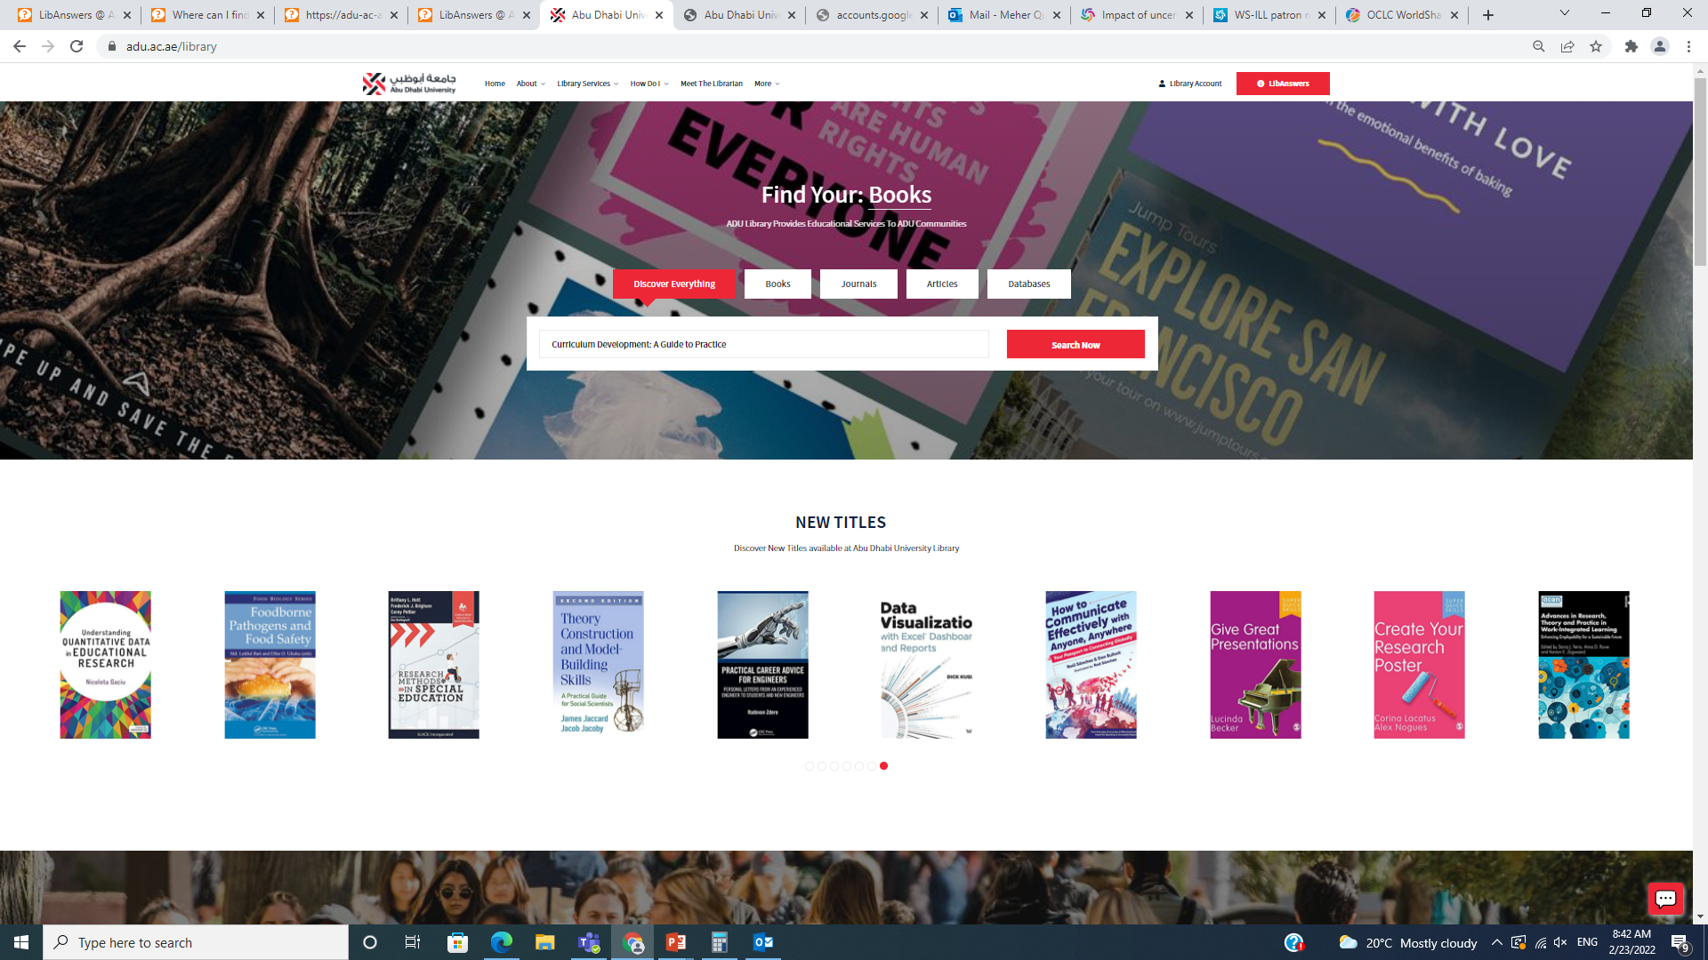
The Library Website
Link: http://adu.ac.ae/library

Slide 4
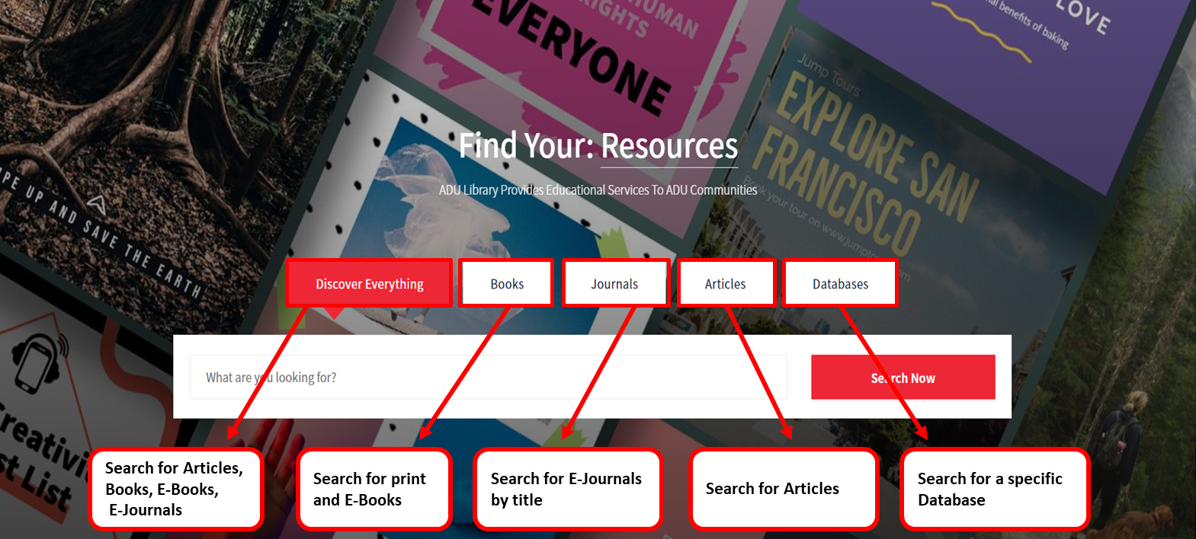
The Library Resources

Slide 5
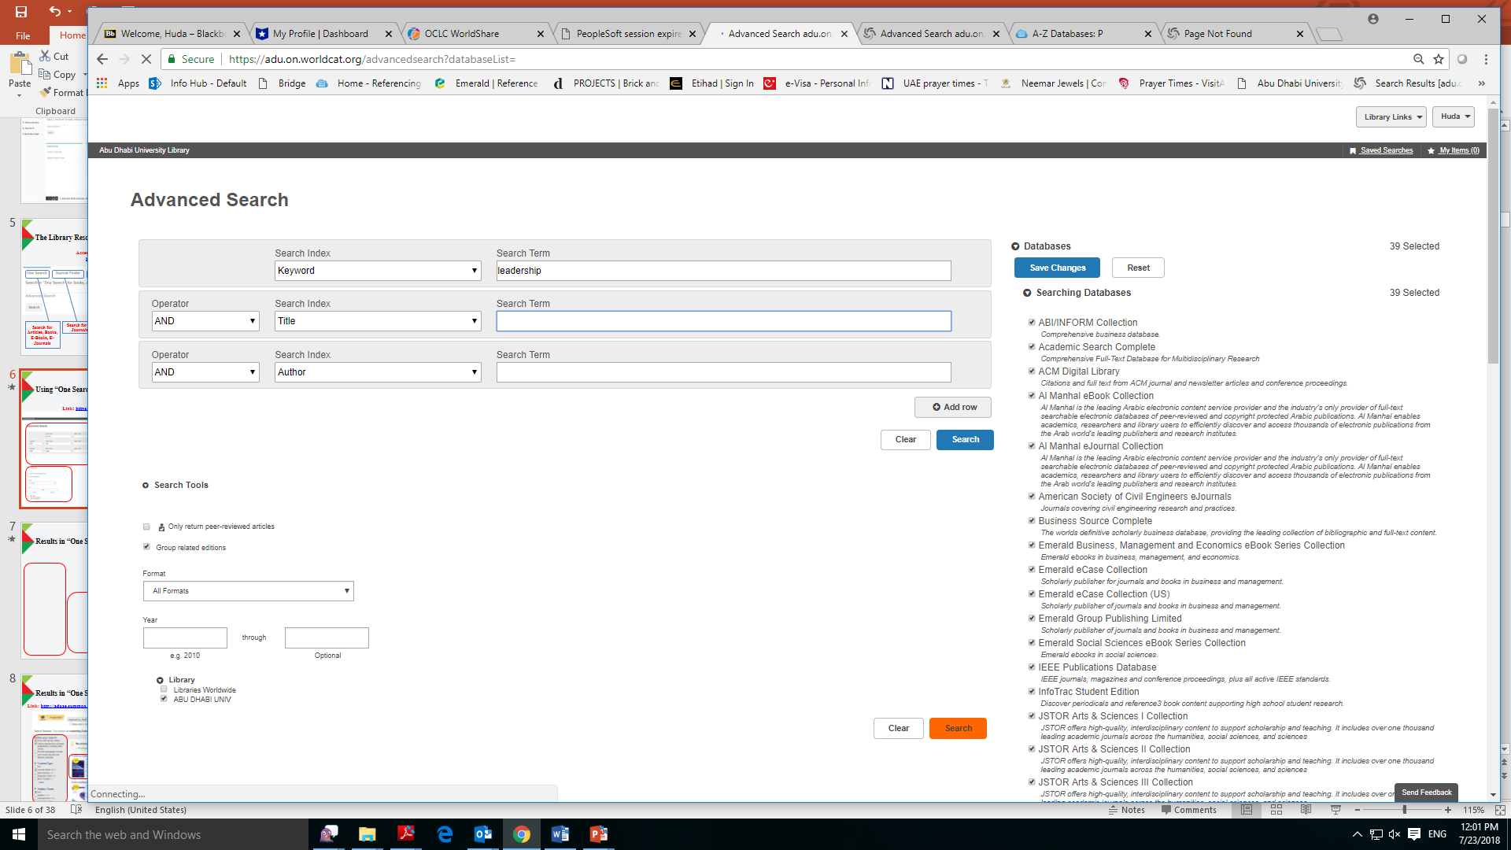
Using “One Search”
Link: https://adu.on.worldcat.org/discovery

Slide 6
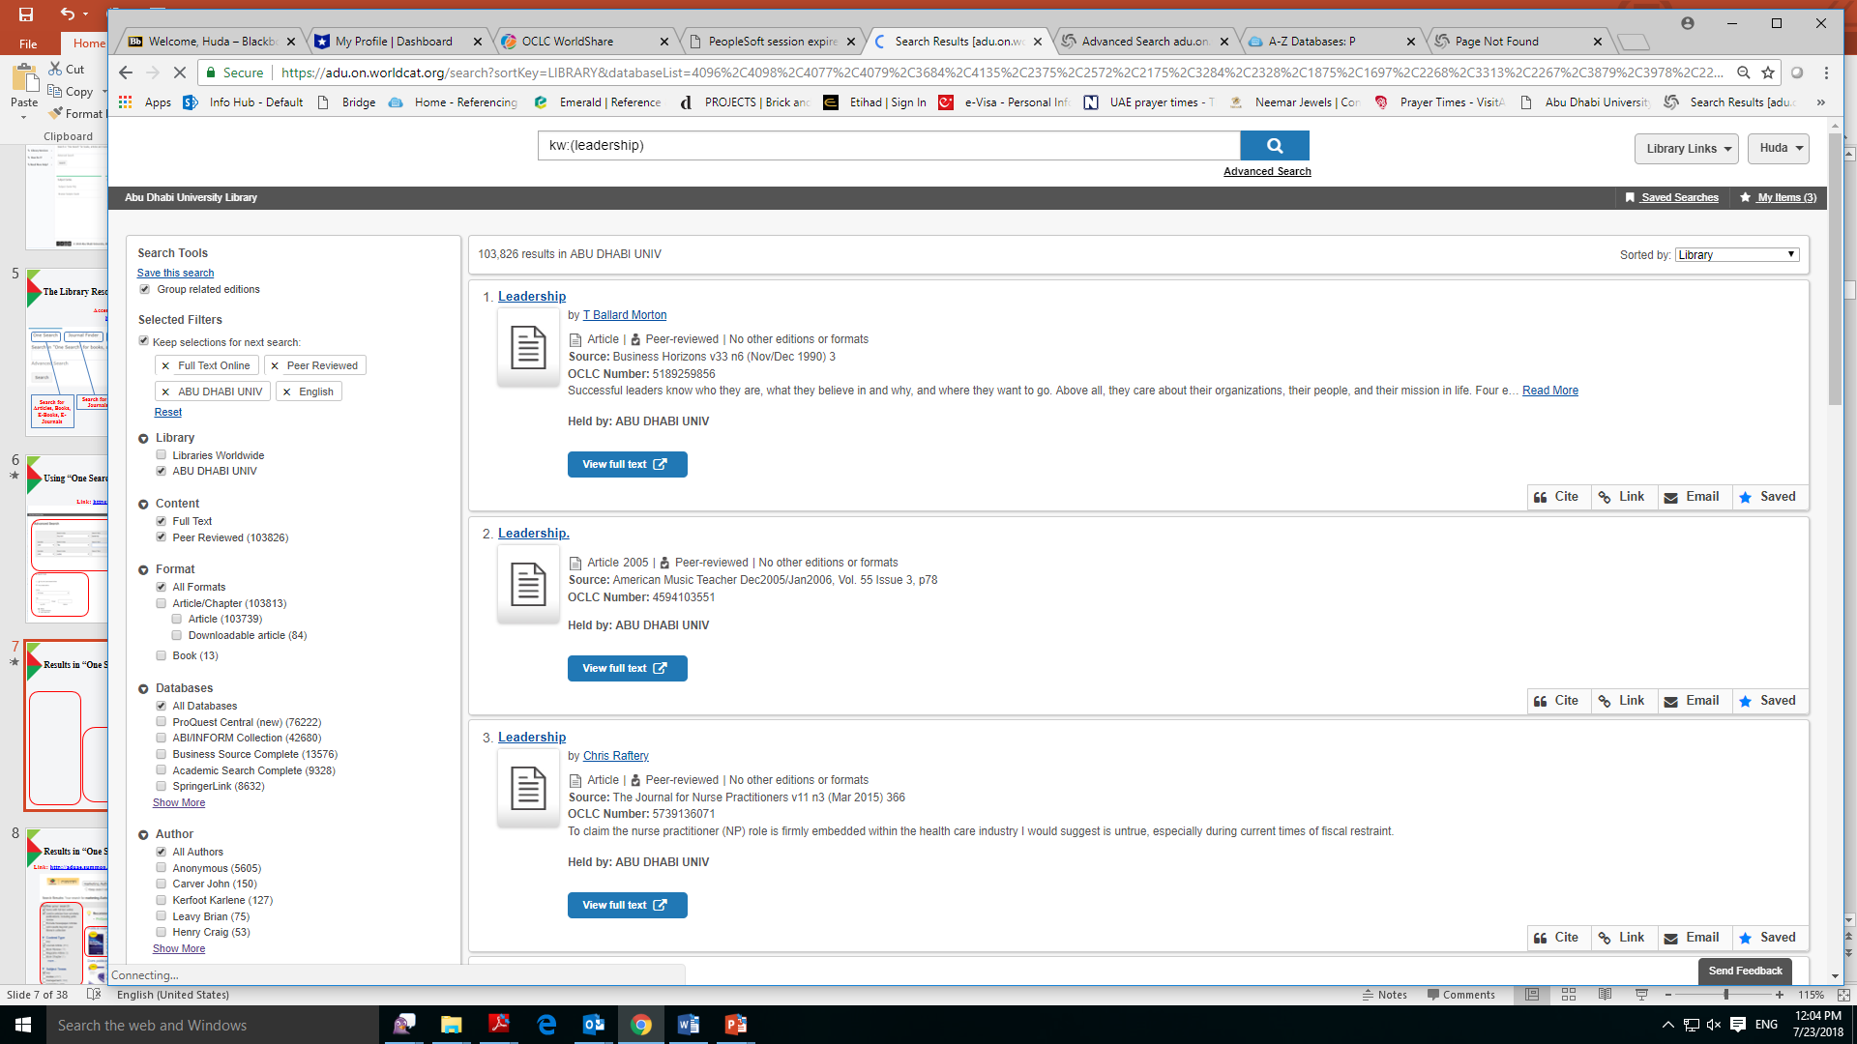
Searching for Articles on “One Search”

Slide 7
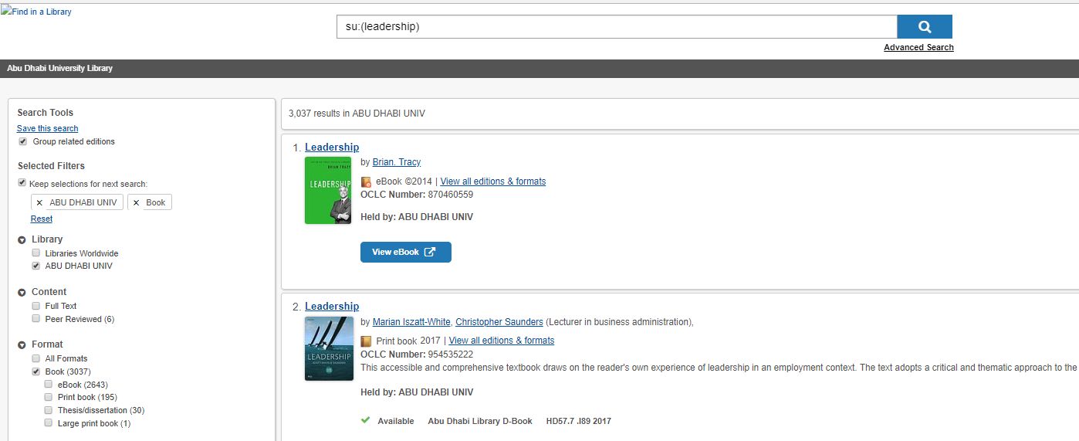
Searching for Books/E-books on “One Search”

Slide 8
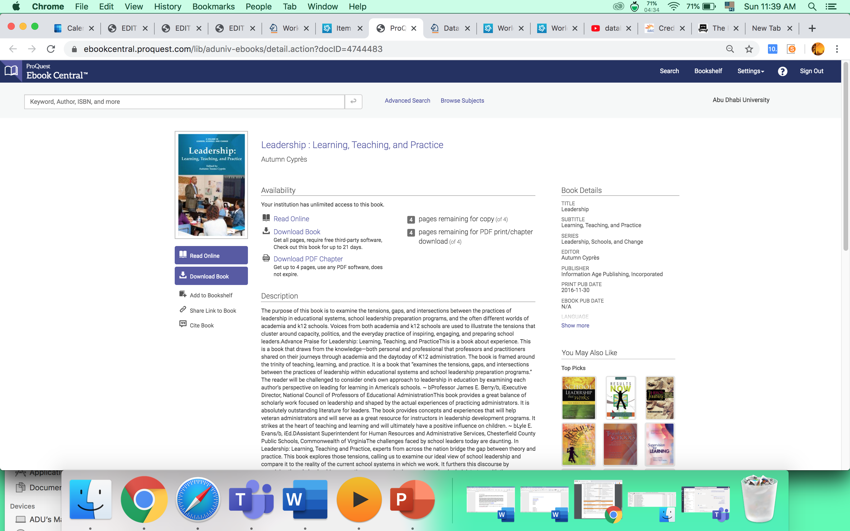
Using E-books in ProQuest Ebook Central

Slide 9
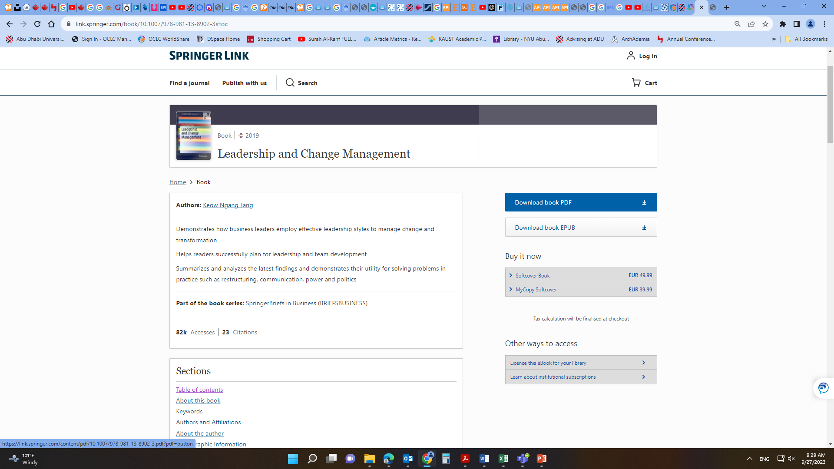
Using E-books in Springer

Slide 10
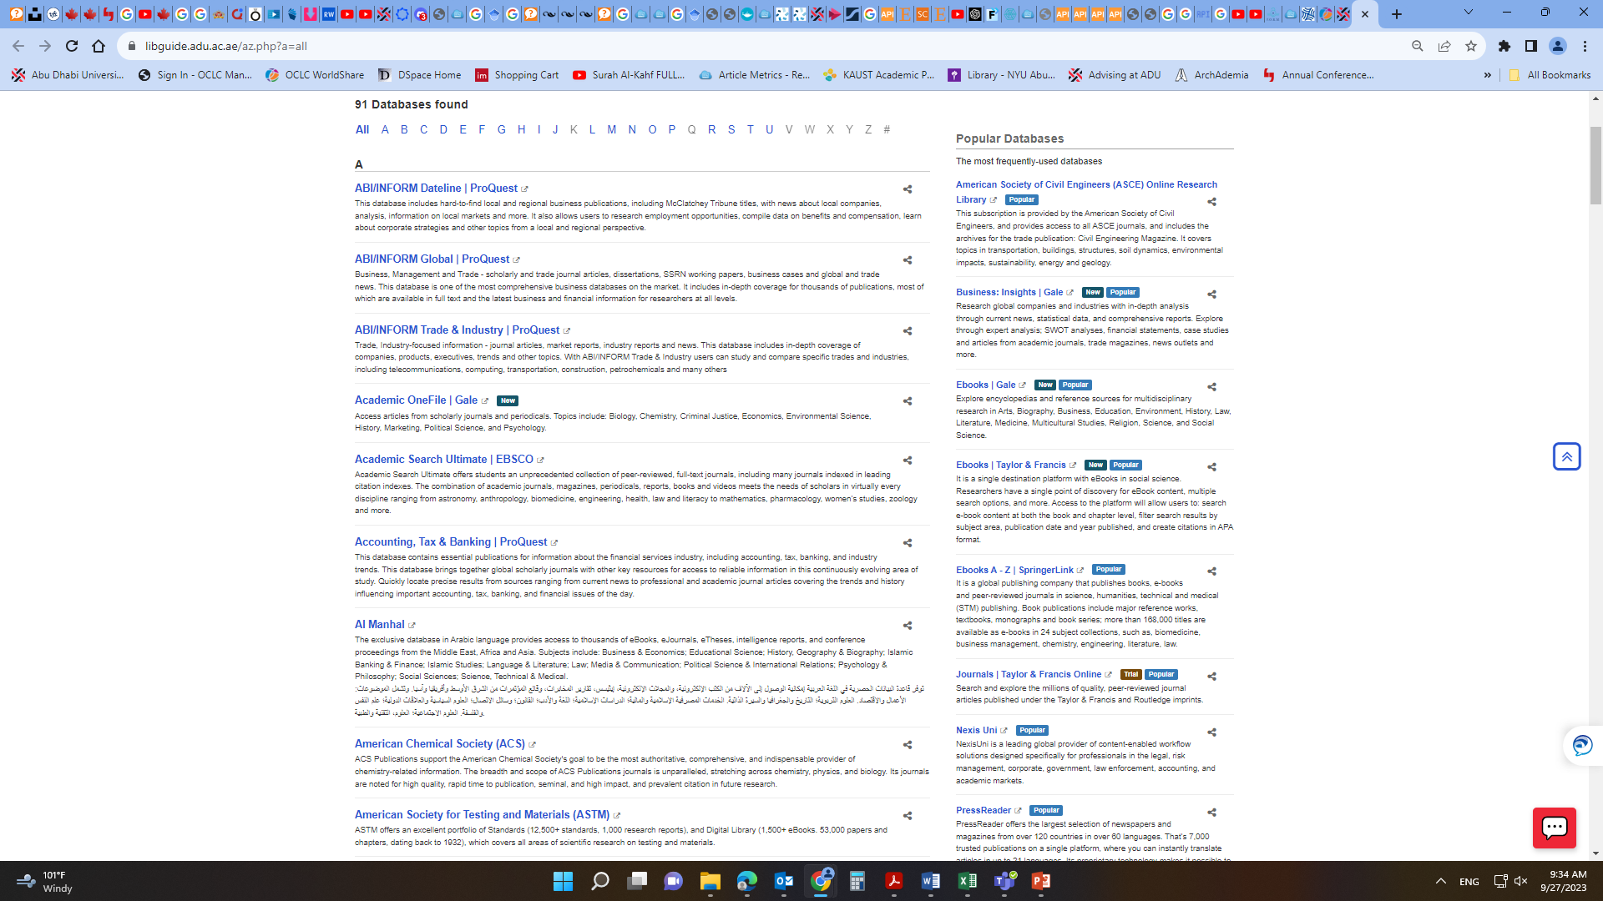
Using the Databases – Off-Campus
Access All Databases (Off-Campus) on: http://libguide.adu.ac.ae/az.php

Slide 11
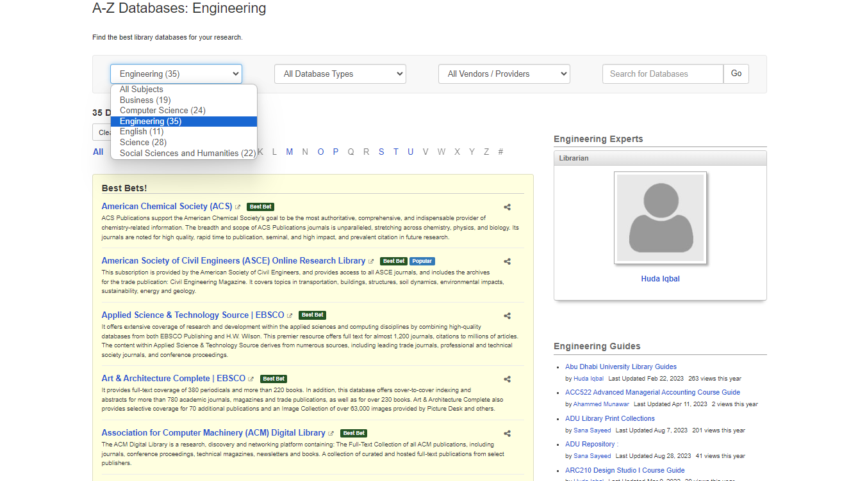
Using the Databases – Off-Campus
Specialized Databases

Slide 12
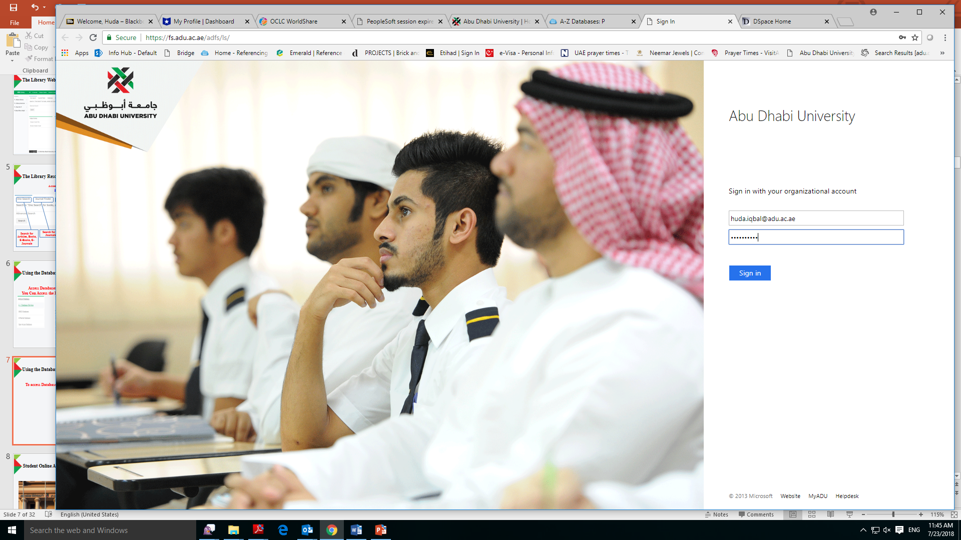
Using the Databases – Off-Campus
To access Databases, use your ADU Email and Password
ADU Email
and Password
1007000@students.adu.ac.ae
******************

Slide 13
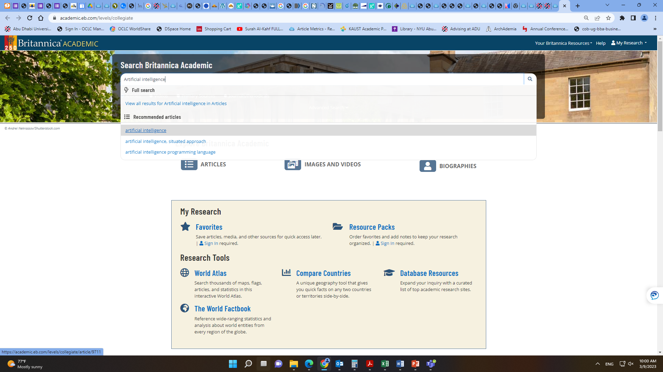
Using Britannica Academic
Search for Articles, Images, Videos, and Facts

Slide 14
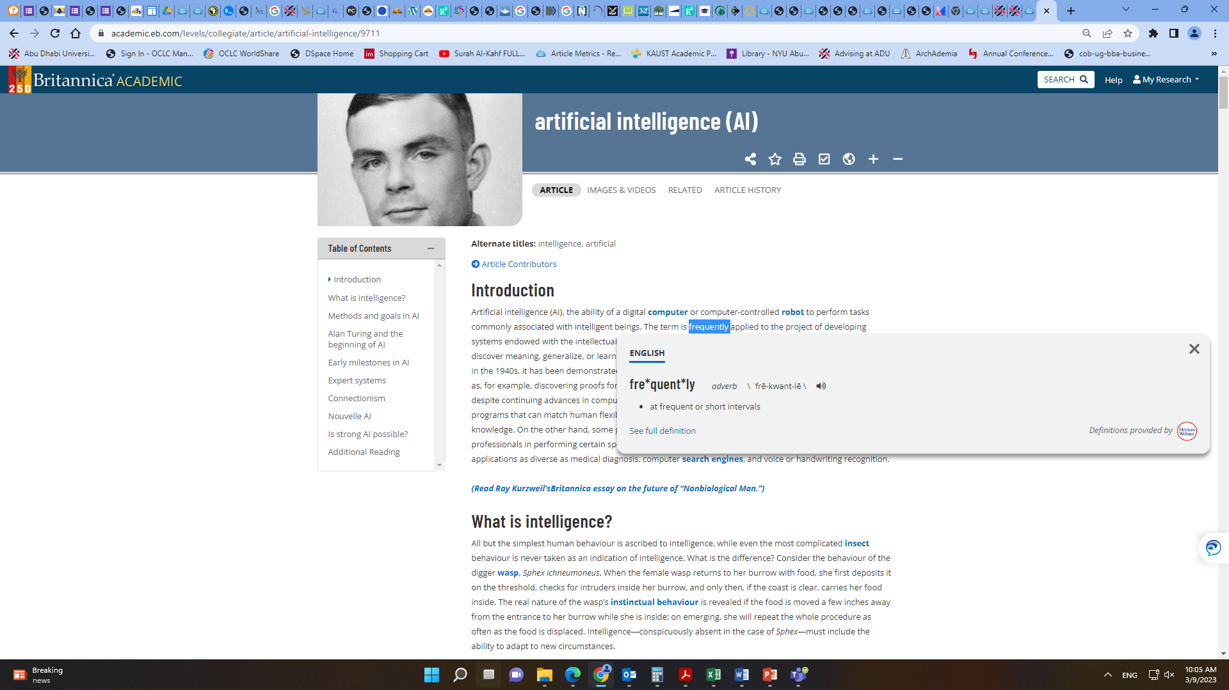
Using Britannica Academic
Helps defining difficult words

Slide 15
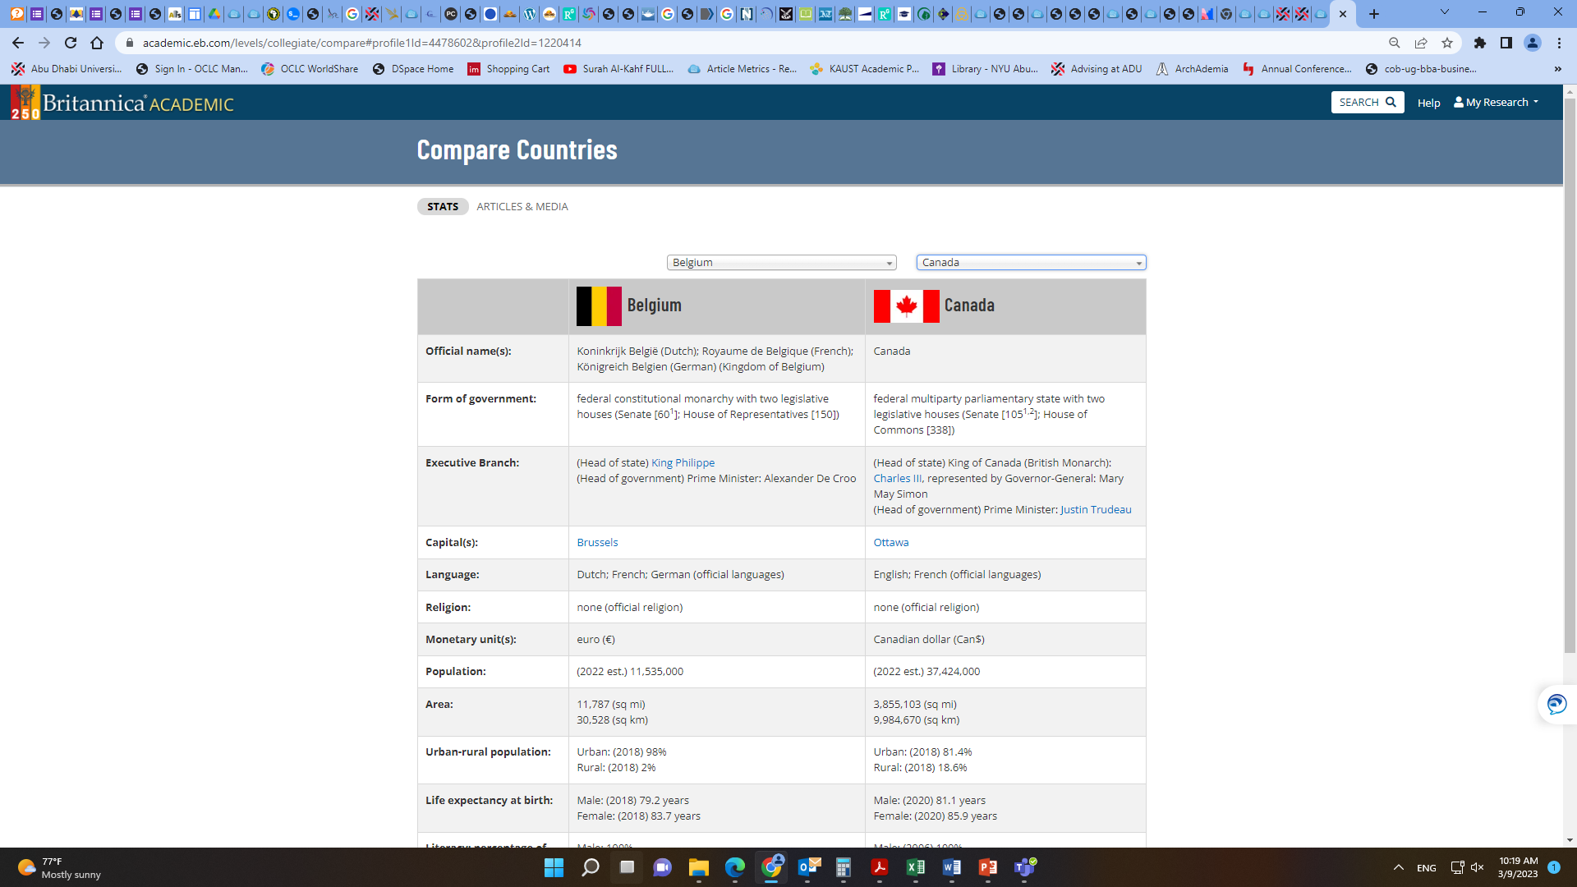
Using Britannica Academic
Compare Countries to find interesting facts

Slide 16
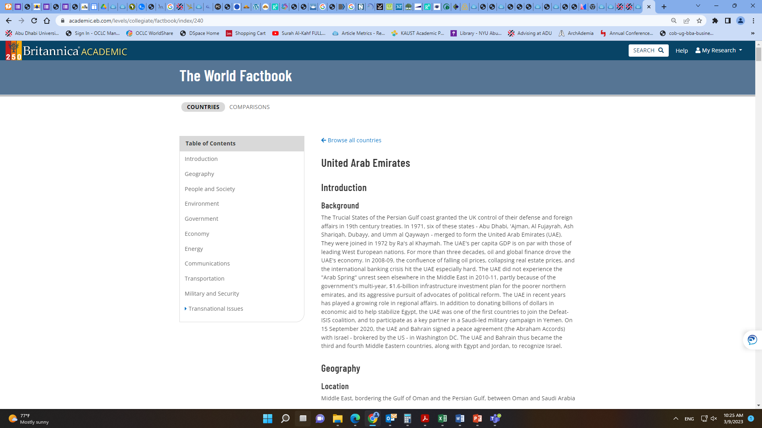
Using Britannica Academic
Use the World Factbook to explore Countries

Slide 17
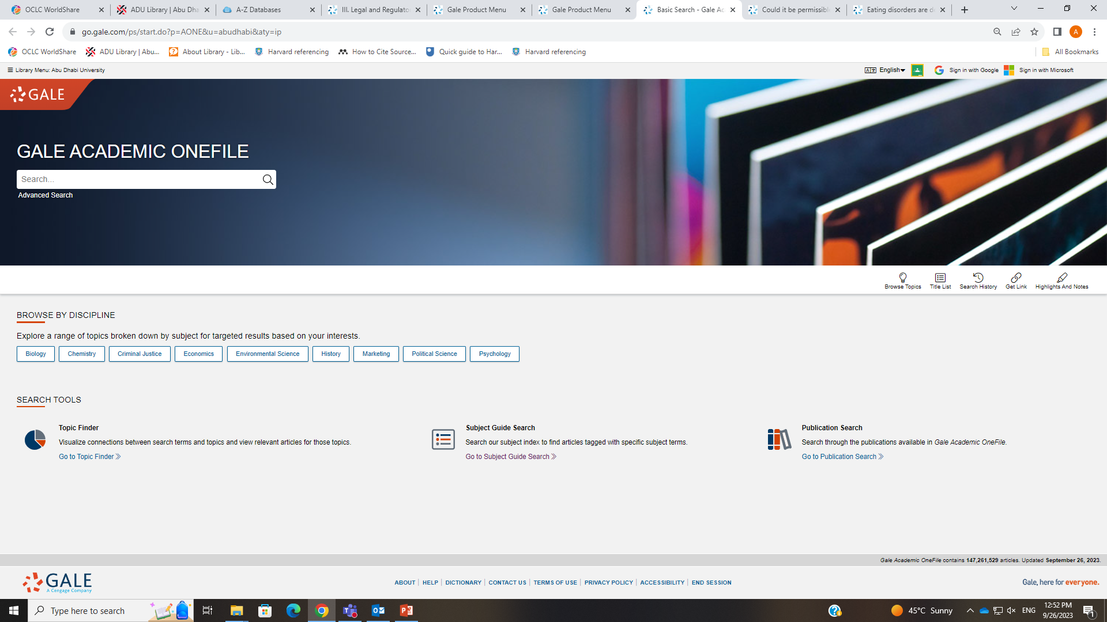
Using Gale
Best for Academic Research and Articles

Slide 18
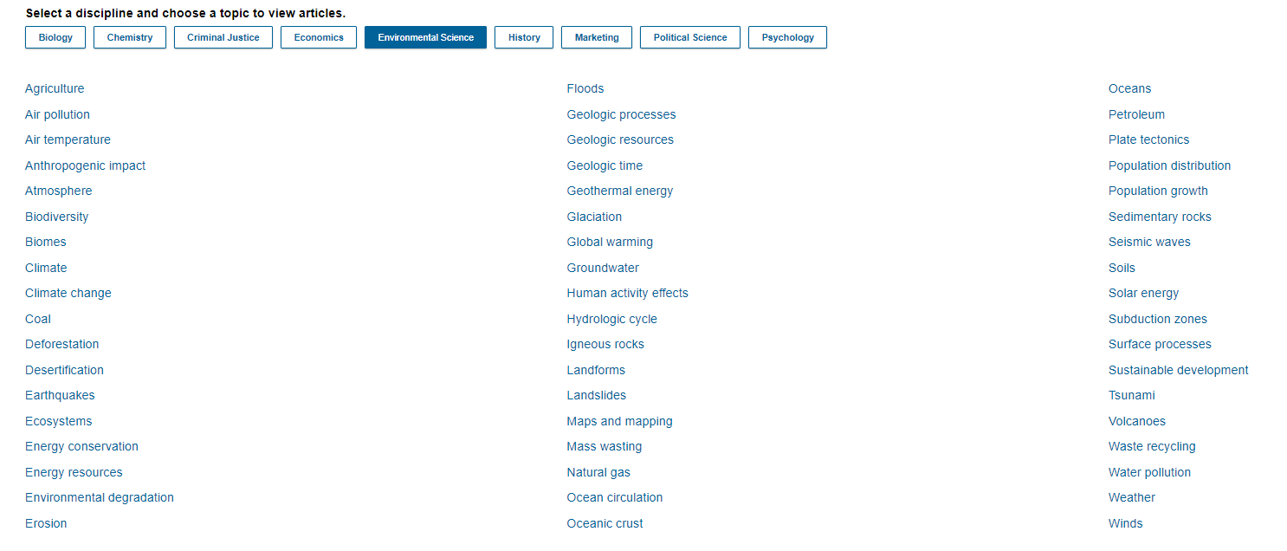
Using Gale
Selecting Topics for Articles

Slide 19
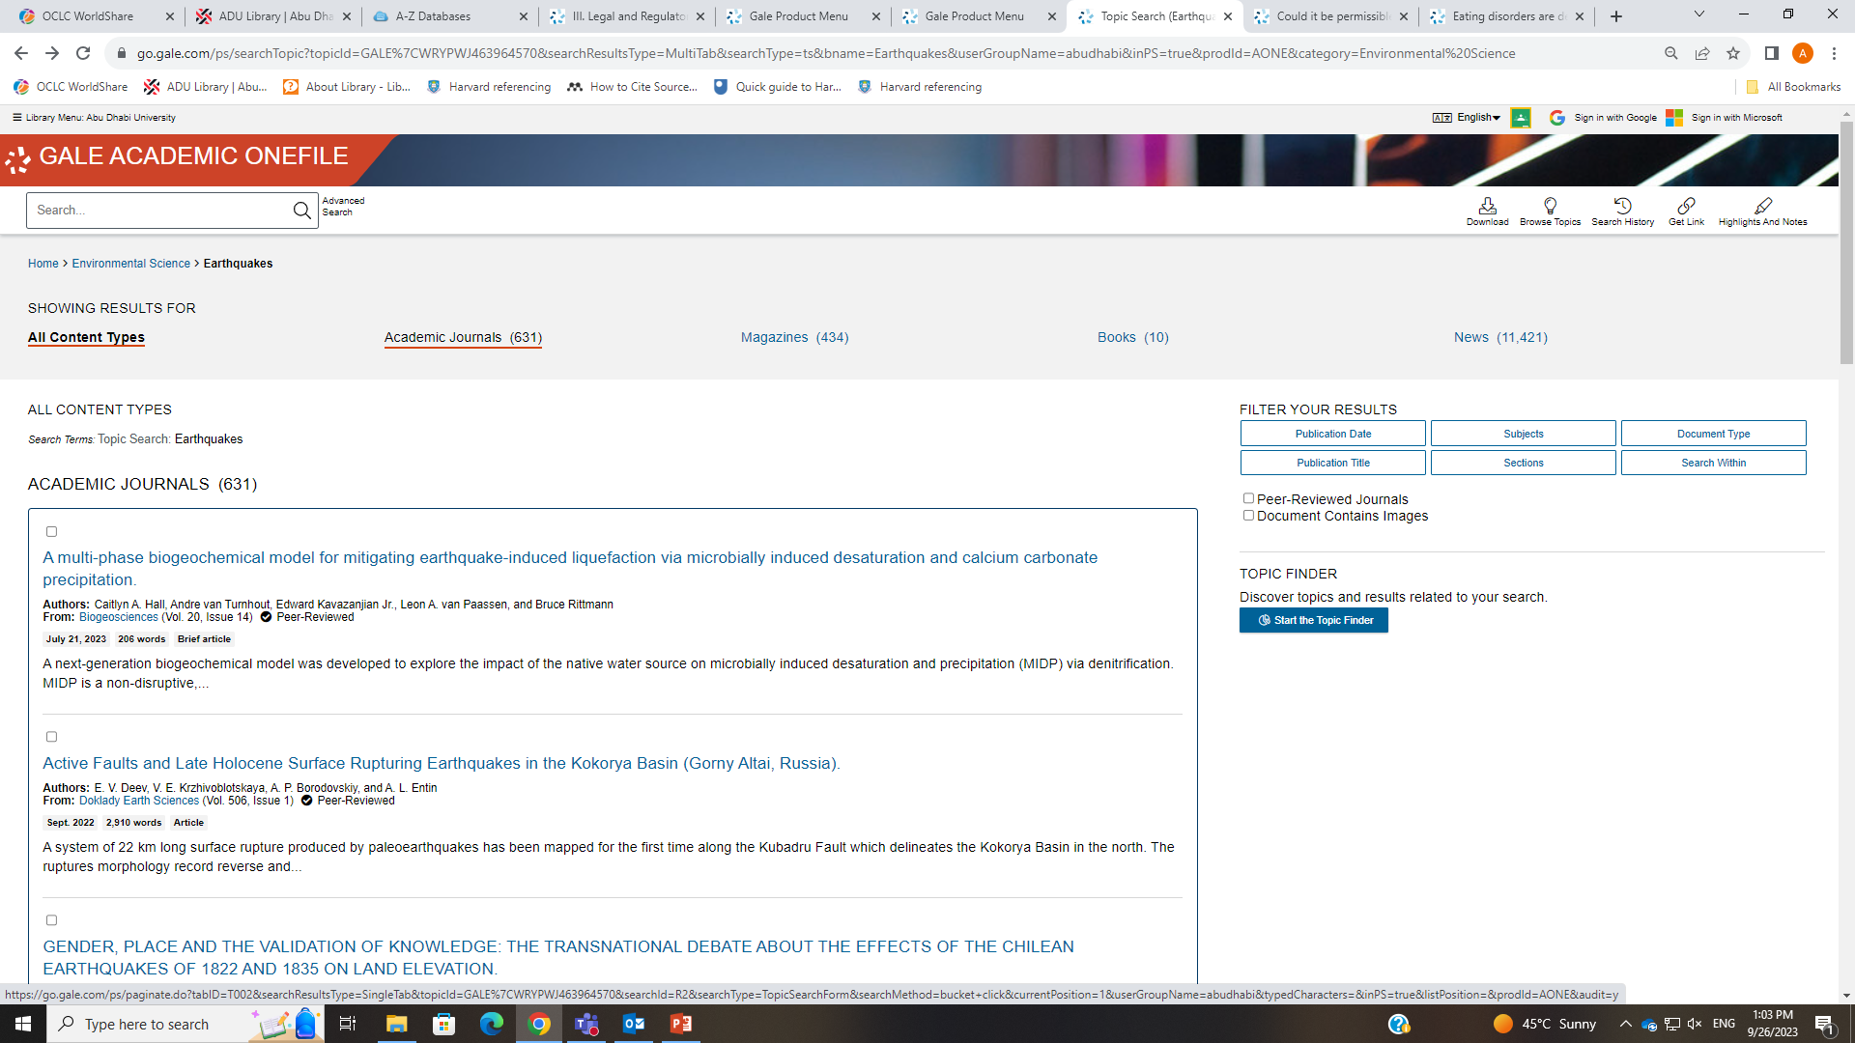
Using Gale
Selecting Topics for Articles

Slide 20
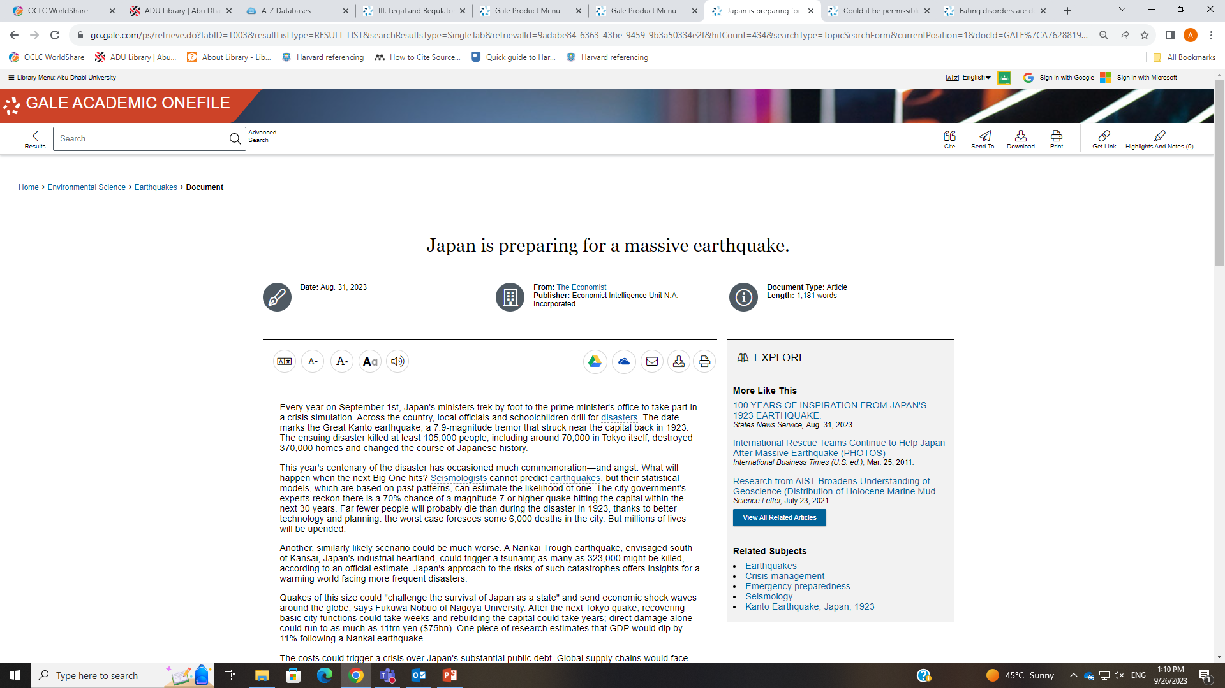
Using Gale
Selecting Articles for Research

Slide 21
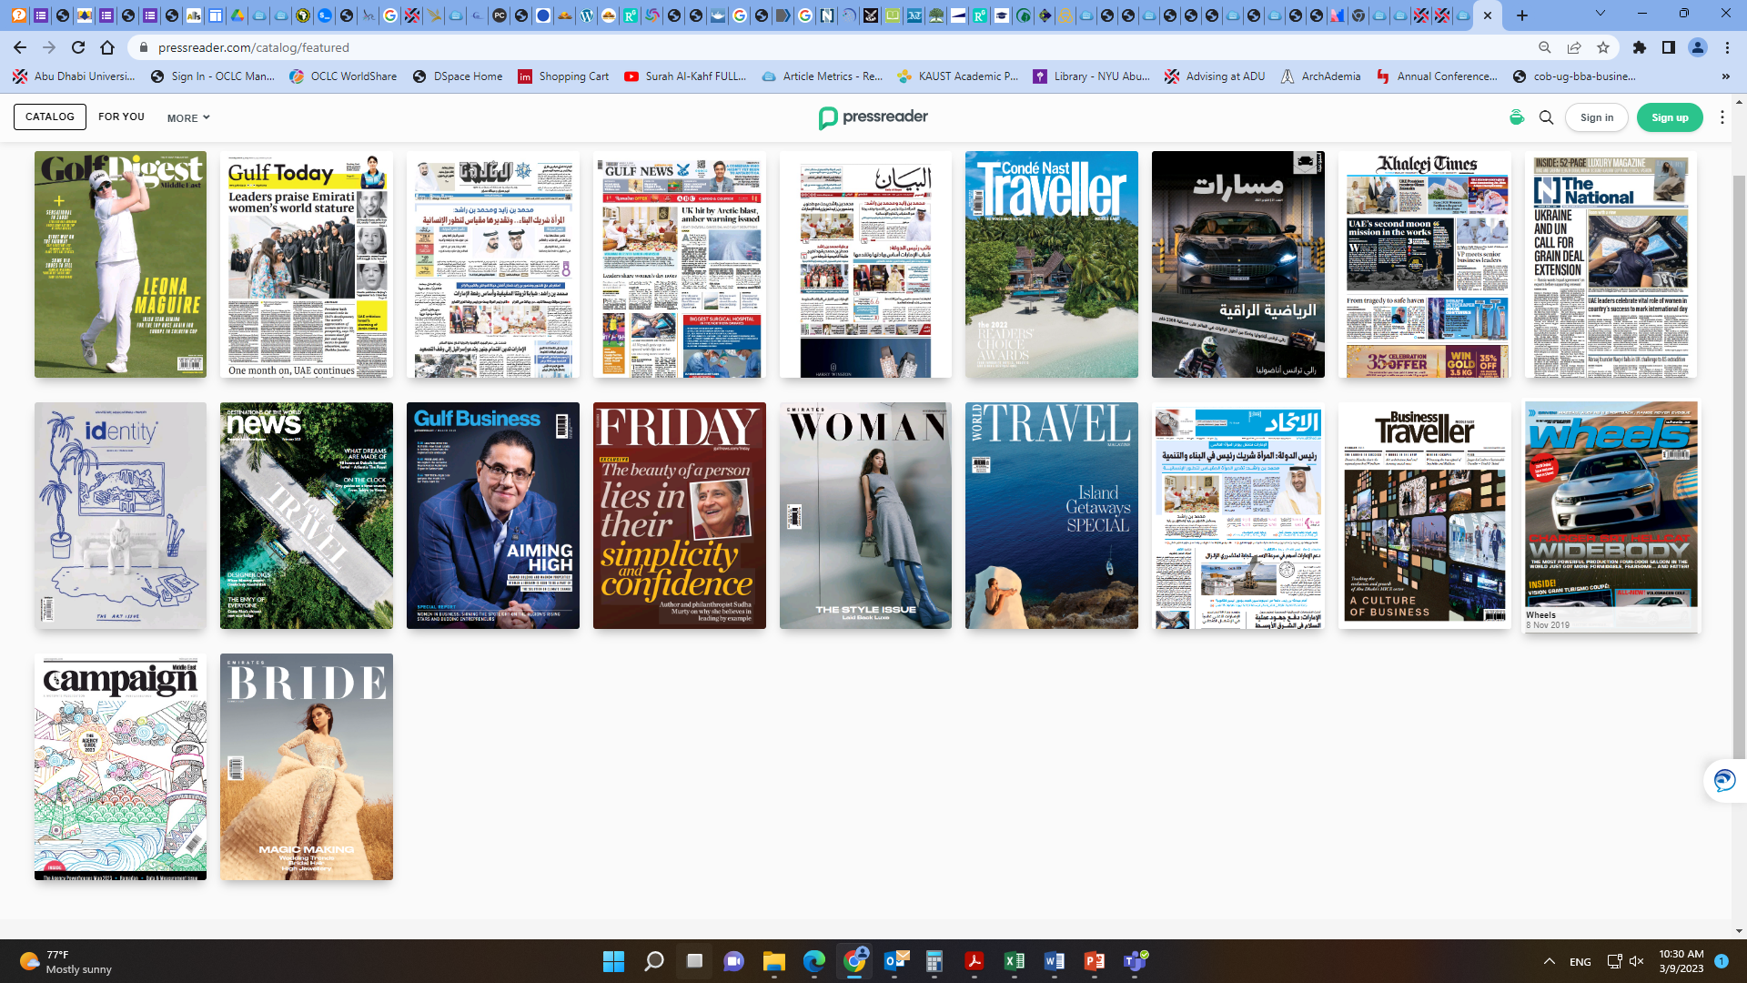
Using PressReader
Newspapers and Magazines at your Fingertips

Slide 22
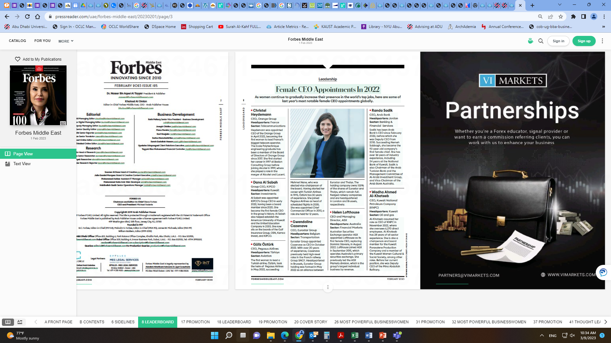
Using PressReader
Newspapers and Magazines at your Fingertips

Slide 23
LibAnswers – Library FAQs
Access Library related FAQs: http://adu-ac-ae.libanswers.com/
https://youtu.be/FtWV_A_4F38

Slide 24
Booking Discussion Rooms Online
Access the Form here: https://www.adu.ac.ae/library/more/library-forms/book-discussion-rooms

Slide 25
Borrowing Services
Patron | Loan Period | Number of Books | Renewals
Undergraduate Students | 14 Days | 5 | 1

Slide 26
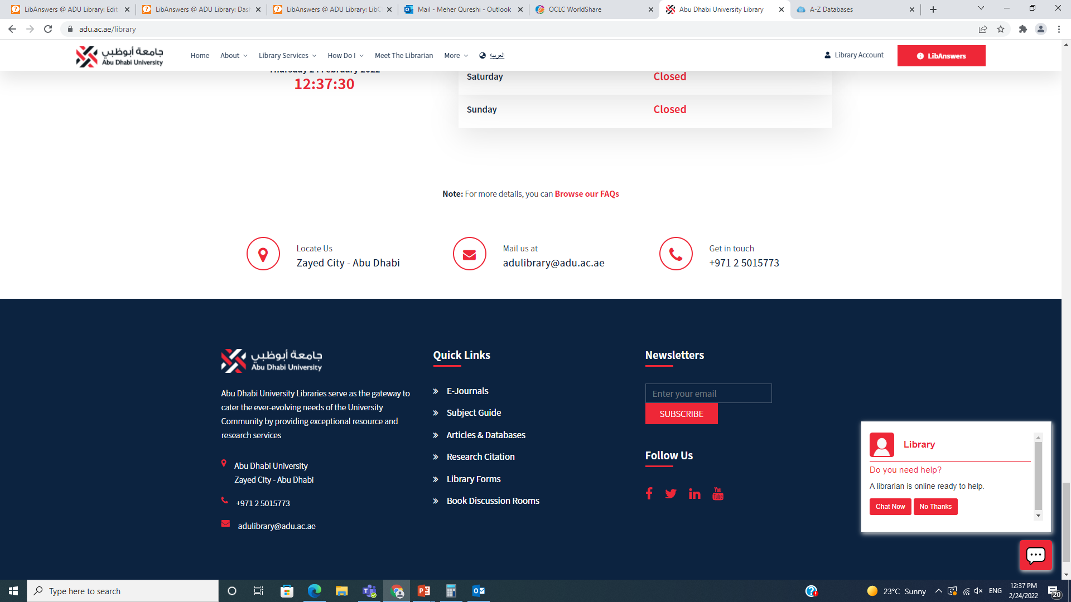
Chat with the Librarian!
Chat with us on the Library website: http://adu.ac.ae/library

Slide 27
Hours of Operation
Abu Dhabi Campus
8 A.M. – 8 P.M. Mondays – Fridays
Al Ain Campus
8 A.M. – 8 P.M. Mondays – Fridays
Dubai Campus
8 A.M. – 6 P.M. Mondays – Fridays

Slide 28
Questions?
Thank You!

